Slide 1
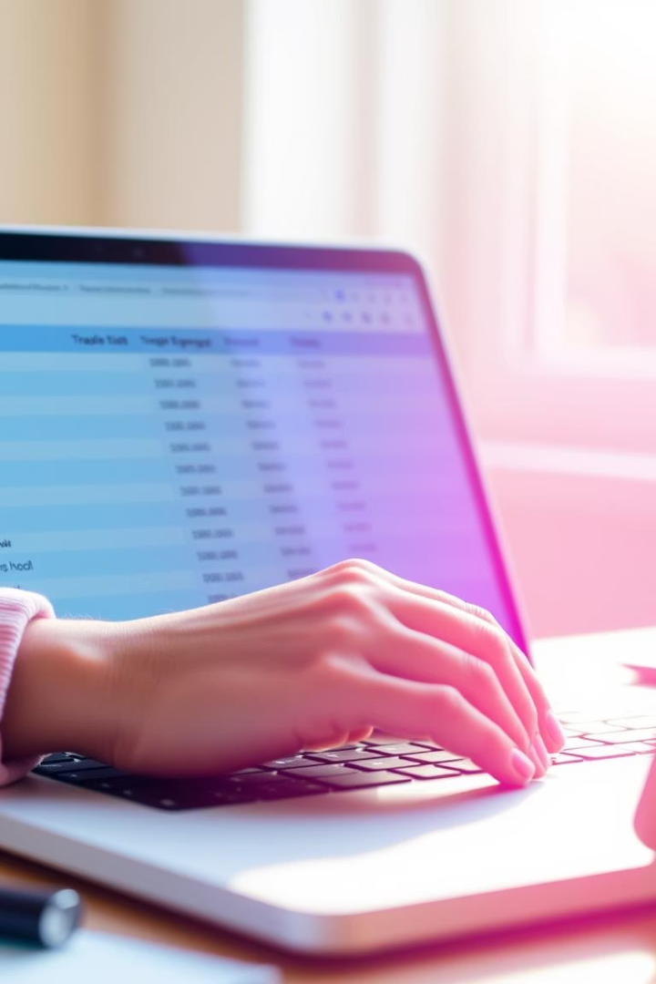
Expense Tracker Project
Presentation of project by group members :-
Roll No Name
78 Vaishnavi Sardar Patil
97 Shraddha Nilesh Sonawane
99 Tejashree Chandrakant Jadhav
100 Vaishnavi Kashinath Gawade
vp

Slide 2
Problem Statement
Unorganized Tracking of Daily Expenses: Many individuals struggle to keep a proper record of their daily income and expenses, which leads to difficulty in managing their personal finances effectively.
Lack of Visual Summaries or Monthly Reports: Users often do not have access to clear summaries or categorized reports, making it hard to understand where most of their money is being spent.
Absence of a Simple Digital Tool: There is a need for a simple, user-friendly application that allows users to digitally record, view, and analyze their financial transactions without requiring advanced technical knowledge.

Slide 3
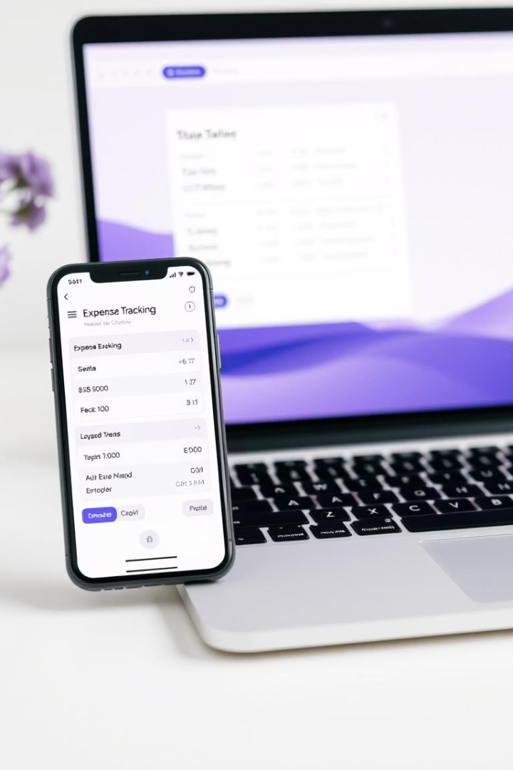

Introduction to Expense Tracker
Purpose of the system
Problem statement
Many people struggle to track their spending effectively, leading to poor financial decisions.
To provide users with a convenient way to record, analyze, and manage daily expenses.
Solution overview
The system uses Java to create an intuitive and secure application that categorizes expenses and provides insights.

Slide 4

Project Objectives
Accurate Expense Recording
Ensure all user expenses are captured precisely with relevant details like date, category, and amount.
Expense Categorization
Automatically group expenses into predefined and customizable categories for better organization.
Report Generation
Provide detailed spending summaries and trends over selected periods to support financial planning.
User Friendly Interface
Create an easy-to-navigate application enabling efficient data entry and retrieval.

Slide 5
System Architecture
UI Layer (Swing):
Shows buttons, table, labels (e.g., Add, Report, Filter).
Built with JFrame, JTable, JComboBox, etc.
2.Logic Layer:
Handles user actions, updates table, calculates balance.
Manages the list of Transaction objects.
Data Layer (File I/O):
Reads/writes transaction data to transactions.txt.
4.Model Layer:
Transaction class stores data (type, amount, category, date, description).

Slide 6





Working of the Expense Tracker System
Input Entry
The user enters expense details including amount, category, and date.
Validation
The system verifies data correctness and completeness before processing.
Processing
Expenses are categorized and stored securely in the system database.
Output & Reports
Users can generate visual reports summarizing their spending behavior over chosen intervals.

Slide 7
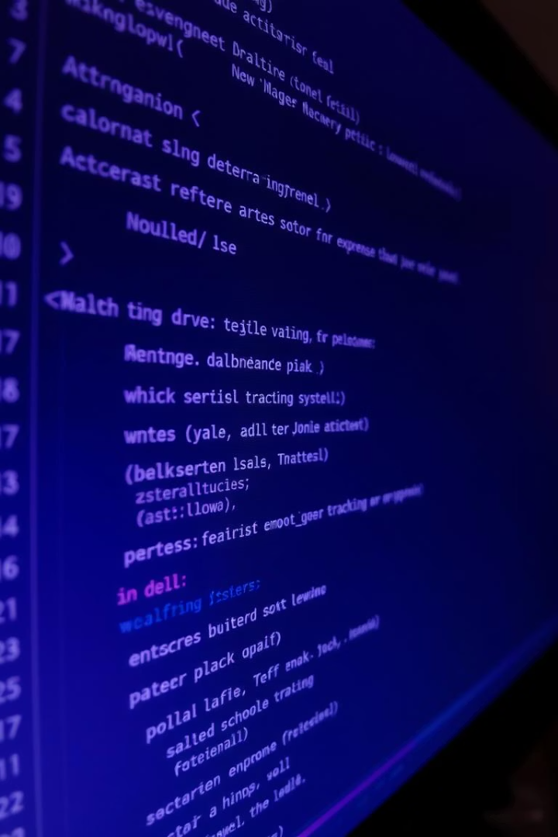
Java Concepts Used in Expense Tracker
Object-Oriented Programming
Use of classes and objects to model expenses, users, and application components, promoting modularity.
Exception Handling
Robust error detection and management ensures smooth user experience and prevents crashes.
File Handling
Persistence of expense records using Java I/O for saving and loading data from files.
Collections Framework
Utilizing lists, maps, and sets to efficiently store and retrieve expense data and categories.

Slide 8

Conclusion
Future Enhancements
User Benefits
Possibility to integrate mobile platforms, cloud storage, and advanced analytics for deeper insights.
Successful Implementation
Users gain insight into their spending habits and can manage money proactively.
The project effectively provides a reliable tool for personal finance management.

